Slide 1

KHATRA ADIBASI MAHAVIDYALAYA
P.O- Khatra, Dist.-Bankura, West Bengal, Pin-722140
Name of the Teacher- Monojit Mondal
Class- B.A. Program in Physical Education 5th semester
Subject- Physical Education
Course : Indigenous & Minor Game and Excursion- Camping Program
Topic- Skills of Holding
Session: 2021-22

Slide 2
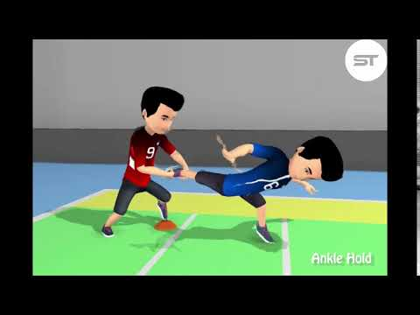
Skills of Holding
Ankle Hold: The corner defenders usually initiate this tackle wherein they grab the ankle of the raider while he is attempting to sneak in a bonus point or a toe touch.

Slide 3
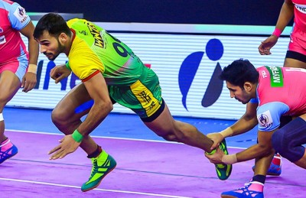
Ankle Hold

Slide 4
Diving Ankle hold
: This is slightly different than the normal ankle hold, here the corner defenders dive to the legs of the raider. Here the defender tries to lock both legs of the raider in his hands to stop the movement entirely. For this cover support is very essential as the upper body of the raider could still be in motion and try to escape Young defenders try this often, but the success rate is low for this tackle type.

Slide 5
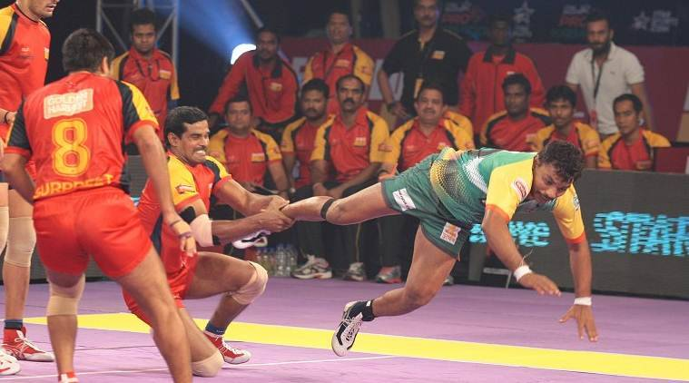
Diving Ankle hold

Slide 6
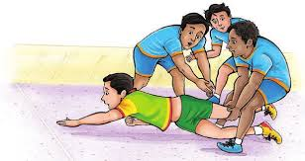
Thigh Hold:
This technique is exhibited by many cover defenders, who strike at the right time when the raider is switching his direction and hold his thighs with both hands, thus pinning him down.

Slide 7
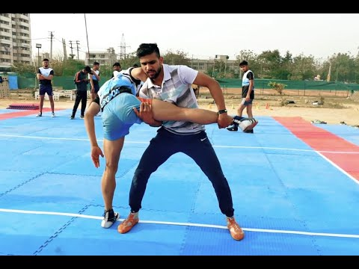
Thigh Hold

Slide 8
Back/Waist Hold
: This tackle requires brute strength to be executed, wherein the defenders grab the raider by his waist or back depending on the raiders position and then hauls him mid-air to disturb his balance and thus effectively marring his chance of escape. Important to have team coordination to pull it off as the lower body dangling should be taken care of by the other team mates or else it could be a multiple point raid for the raider.

Slide 9
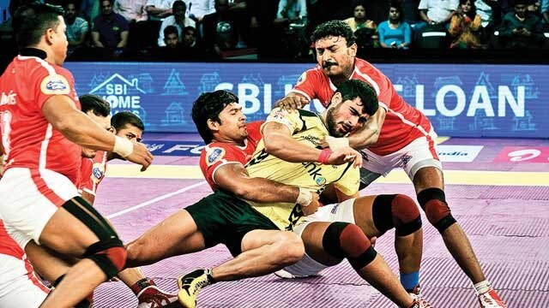
Back/Waist Hold

Slide 10
REFERENCES
https://www.google.com/search?q=Back%2FWaist+Hold+KABADDFI&tbm=isch&ved=2ahUKEwjHy9nNpc78AhXJj9gFHcvqDcUQ2-cC
https://www.google.com/search?q=Back%2FWaist+Hold+KABADDFI&tbm=isch
https://www.google.com/search?q=Back%2FWaist+Hold+KABADDFI&tbm=isch&ved

